Slide 1


Game Engines 1
Using a Physics Engine
Dr Bryan Duggan
DIT School of Computing
bryan.duggan@dit.ie
@ditcomputing
http://facebook.com/ditschoolofcomputing

Slide 2
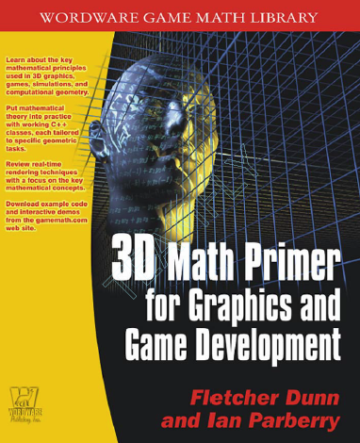
A brilliant book! (does not cover physics though ☹)

Slide 3
Physics Engines
Simulation of certain physical systems, such as
Rigid body dynamics (bodies can never deform)
Collision detection (geometric primitives & tri-meshes)
Soft body dynamics (cloth and deformable objects)
Fluid dynamics (smoke, water)
Real-time (sacrifices accuracy for speed, but will anybody notice?)

Slide 4




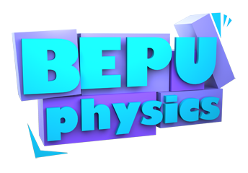
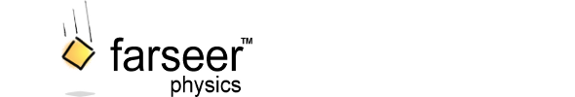
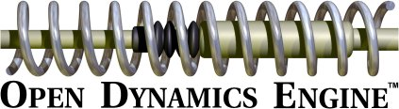
Some of the major players

Slide 5
Wee will use Bullet Physics
100% Free and Open Source
In fact you have to compile from sources
Android, PC, Mac, Linux, XBOX, PS3 etc
3D collision detection
Soft body dynamics
Rigid body dynamics
GPU Backend on Bullet 3
Important! Performance is poor unless you compile in release mode
Games & movies that use Bullet…

Slide 6


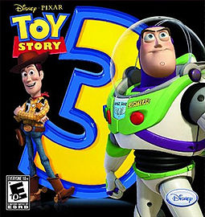


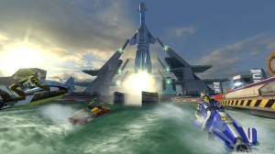


Slide 7
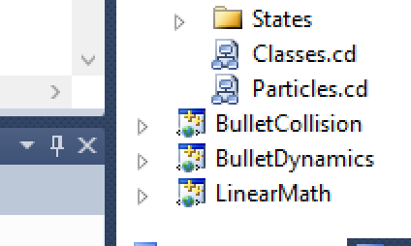
To use Bullet
You must compile in three projects
Add the header search path (no lib required)
Add:
#include <btBulletDynamicsCommon.h>

Slide 8
In your Initialise function:
// Boilerplate code
collisionConfiguration = new btDefaultCollisionConfiguration();
dispatcher = new btCollisionDispatcher(collisionConfiguration);
// The world
btVector3 worldMin(-1000,-1000,-1000);
btVector3 worldMax(1000,1000,1000);
// What broadphase algorithm to use
broadphase = new btAxisSweep3(worldMin,worldMax);
// What solver algorithm to use
solver = new btSequentialImpulseConstraintSolver();
// You create a world object and add rigid bodies to it
dynamicsWorld = new btDiscreteDynamicsWorld(dispatcher,broadphase,solver,collisionConfiguration);
dynamicsWorld->setGravity(btVector3(0,0,0));

Slide 9
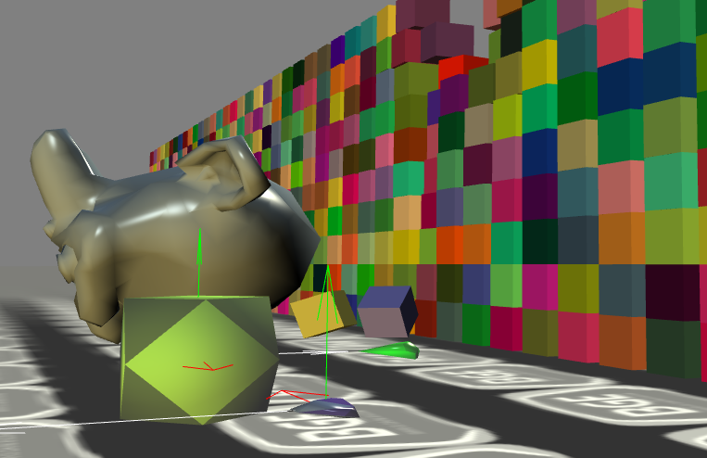
Rigid bodies
Never deform
Constant
Mass
Inertial tensor
Changes over time:
Position vector of the body's centre of mass
Linear velocity of the point of reference, a vector
Orientation of a body, represented by a quaternion
Angular velocity vector which describes how the orientation changes over time
Calculated
Force accumulator
Torque accumulator
Acceleration
Shape
Used for collisions
Often a primitive
Simplified version of the mesh
Cube, cylinder, cone, capsule
Or a tri-mesh with a few hundred vertices

Slide 10
Bullet RigidBodies
Dynamic
Positive mass
Every frame has it’s position and quaternion recalculated
Example next…
Static
0 mass
Cannot move, but other things can collide with this
Kinematic
Zero mass
Can be animated by the user
Will affect other rigid bodies in the sim
Will not be affected by other rigid bodies in the sim

Slide 11
shared_ptr<PhysicsController> PhysicsFactory::CreateBox(float width, float height, float depth, glm::vec3 pos, glm::quat quat)
{
// Create the shape used for collision detection
btCollisionShape * boxShape = new btBoxShape(btVector3(width, height, depth) * 0.50);
btScalar mass = 1;
btVector3 boxInertia(0,0,0);
boxShape->calculateLocalInertia(mass,boxInertia);
// This is a container for the box model. Used for drawing
shared_ptr<Box> box = make_shared<Box>(width, height, depth);
box->worldMode = GameComponent::from_child;
box->position = pos;
Game::Instance()->Attach(box);
// Create the rigid body
btDefaultMotionState * boxMotionState = new btDefaultMotionState(btTransform(GLToBtQuat(quat)
,GLToBtVector(pos)));
btRigidBody::btRigidBodyConstructionInfo fallRigidBodyCI(mass, boxMotionState, boxShape, boxInertia);
btRigidBody * body = new btRigidBody(fallRigidBodyCI);
body->setFriction(567);
dynamicsWorld->addRigidBody(body);
// Create the physics component and add it to the box. This links Bullet with BGE
shared_ptr<PhysicsController> boxController = make_shared<PhysicsController>(PhysicsController(boxShape, body, boxMotionState));
boxController->tag = "Box";
body->setUserPointer(boxController.get());
body->setCollisionFlags(body->getCollisionFlags() | btCollisionObject::CF_CUSTOM_MATERIAL_CALLBACK);
box->Attach(boxController);
return boxController;
}

Slide 12
The PhysicsController
void PhysicsController::Update(float timeDelta)
{
btTransform trans;
rigidBody->getMotionState()->getWorldTransform(trans);
position = BtToGLVector(trans.getOrigin());
orientation = BtToGLQuat(trans.getRotation());
// Calculate the world transform
GameComponent::Update(timeDelta);
}

Slide 13
Bullet Shapes
Lots of subclasses including:
btBoxShape
Half extents
btConeShape
Around the Y axis
btCylinderShape
Around the Y axis
btCapsuleShape
Around the Y axis
btPlaneShape
htHeightfieldTarrainShape
For a height map
btConvexHullShape – for trimesh shapes

Slide 14
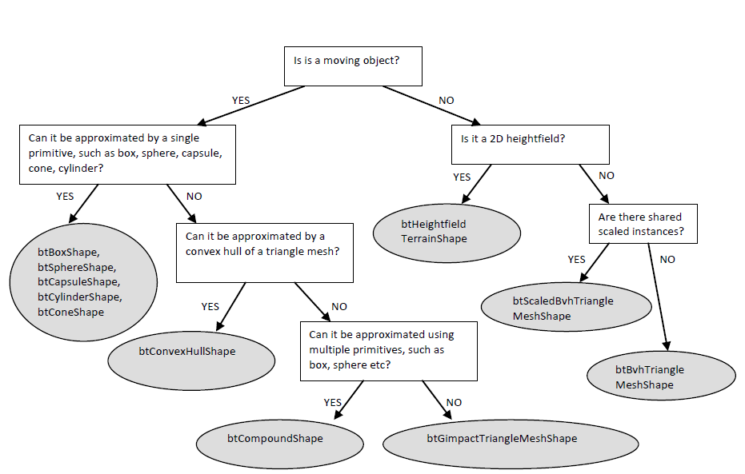

Slide 15
Joints/constraints
Limit the movement of rigid bodies relative to other rigid bodies or the world
Point-to-Point (Ball socket)
Hinge
Slider
Cone Twist
Generic 6 Degrees of Freedom (DoF) Constraint

Slide 16
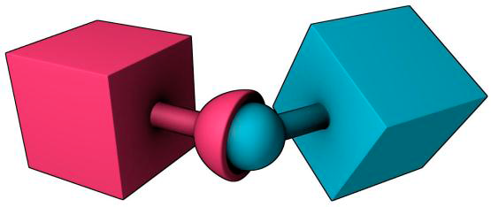
Point To Point
The bodies to constrain
btPoint2PointConstraint (btRigidBody &rbA, btRigidBody &rbB, const btVector3 &pivotInA, const btVector3 &pivotInB)
The centre point of the constraint relative to the local space of each of the rigid bodies

Slide 17
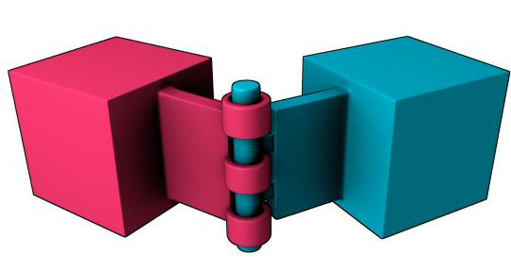
Hinge
btHingeConstraint (btRigidBody &rbA, btRigidBody &rbB, const btVector3 &pivotInA, const btVector3 &pivotInB, const btVector3 &axisInA, const btVector3 &axisInB, bool useReferenceFrameA=false)
The axis around which you want to rotate. This should be the same for both unless one is rotated!

Slide 18
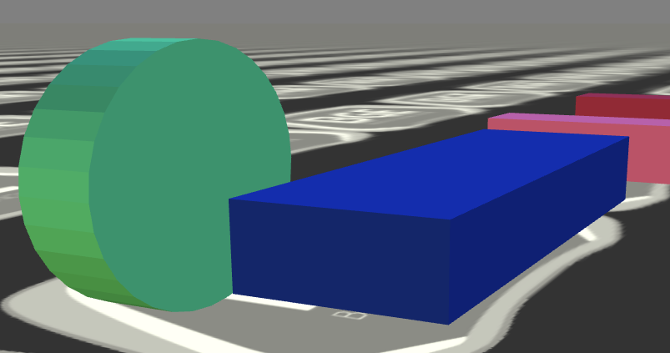
Example…

Slide 19
Example…
box1 = physicsFactory->CreateBox(6,1,2, glm::vec3(15, 5, 0), glm::quat());
cyl = physicsFactory->CreateCylinder(2, 1, glm::vec3(15, 5, -5), glm::angleAxis(90.0f, glm::vec3(1,0,0)));
hinge = new btHingeConstraint(*box1->rigidBody, *cyl->rigidBody, btVector3(0,0,-2),btVector3(0,2,0), btVector3(0,0,1), btVector3(0,1,0), true);
dynamicsWorld->addConstraint(hinge);
The axis for the wheel is rotated because the cylinder is rotated from it’s default. This is still the correct axis relative to default orientation of the cylinder

Slide 20
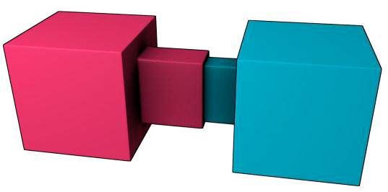
Slider
This is a strange constraint to set up, but easy once you understand that the constraint will attempt to keep the x-axis of both rigid bodies aligned
So the parameter btTransform for each rigid body should rotate the X-Axis to the axis along which you want to slide
Simple! See:
http://www.bulletphysics.org/Bullet/phpBB3/viewtopic.php?f=9&t=2106

Slide 21
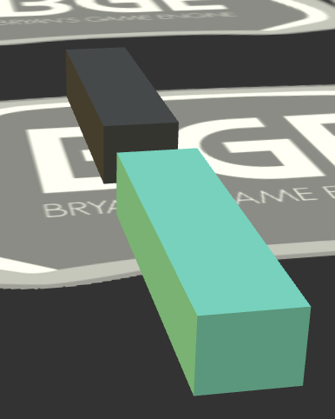
Example
The Z Axis is the axis along which to slide

Slide 22
Example
// A Slider
box1 = physicsFactory->CreateBox(1,1,4, glm::vec3(25, 5, 0), glm::quat());
box2 = physicsFactory->CreateBox(1,1,4, glm::vec3(25, 5, 5), glm::quat());
btTransform box1Transform;
btTransform box2Transform;
box1Transform.setIdentity();
box2Transform.setIdentity();
// You have to make the x axis rotate to the axis you want to slide
// So a 90 Deg rotation around the Y axis will do it
// This makes the X axis into the Z axis
box1Transform.setRotation(GLToBtQuat(glm::angleAxis(90.0f, glm::vec3(0,1,0))));
box2Transform.setRotation(GLToBtQuat(glm::angleAxis(90.0f, glm::vec3(0,1,0))));
btSliderConstraint * slider = new btSliderConstraint(*box1->rigidBody, *box2->rigidBody, box1Transform, box2Transform, true);
dynamicsWorld->addConstraint(slider);

Slide 23
Integration
The process of simulating the rigid body system through time
Each integration step advances the current time by a given step size, adjusting the state of all the rigid bodies for the new time value
dynamicsWorld->stepSimulation(timeDelta,100, 0.01f);
The timeDelta in seconds
Max steps to perform
The fixed time step

Slide 24
stepSimulation
Will try to perform as many steps as necessary in the timeDelta
Example:
If timeDelta was 0.5 then 500 steps with a fixed time delta of 0.01
If it cant keep up then the simulation will appear to slow down as not enough steps will be taken
Bullet can se discrete or continuous collision detection (CCD)

Slide 25
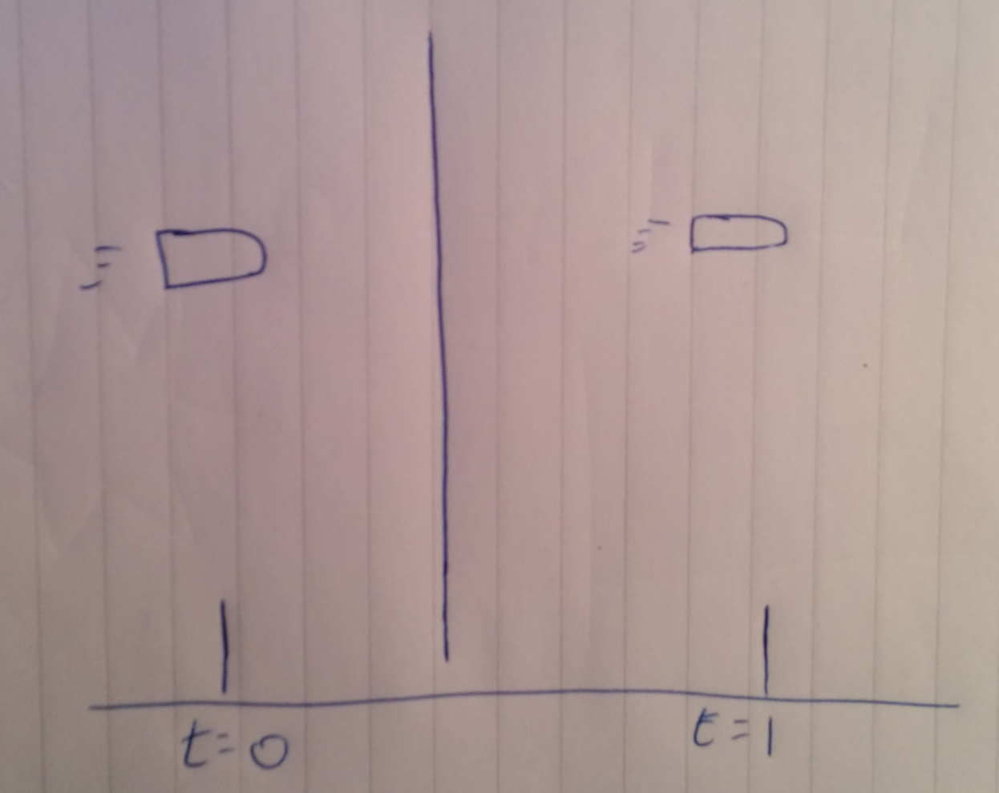
Bullet through paper
An object has a high velocity. The objects new position is calculated based on the timeDelta. The new position is on the far side of a “thin” object that is in the way. The collision detection system has not registered any collision and so it appears as though the object has passed through the “thin” object. See:
http://www.panda3d.org/manual/index.php/Bullet_Continuous_Collision_Detection

Slide 26
Bullet in BGE
PhysicsGame1 / VRGame
A container for the game components
PhysicsController
Attached to a component using world_modes::to_parent
btCollisionShape * shape;
Describes the shape of the body
Used for collision detection
btRigidBody * rigidBody;
Has position, quaternion etc.
btMotionState * motionState;
Sets the default position & quaternion
Must be freed

Slide 27
In update…
void PhysicsController::Update(float timeDelta)
{
btTransform trans;
rigidBody->getMotionState()->getWorldTransform(trans);
position = BtToGLVector(trans.getOrigin());
orientation = BtToGLQuat(trans.getRotation());
// Calculate the world transform
GameComponent::Update(timeDelta);
}
Get the position & quaternion from bullet

Slide 28
PhysicsCamera
A subclass of PhysicsController and btMotionState
Attached to the camera
A Kinematic object (gets updated from the camera)
The function getWorldTransform gets called by Bullet to update the bullet object from the game object
Also implements the Gravity Gun

Slide 29
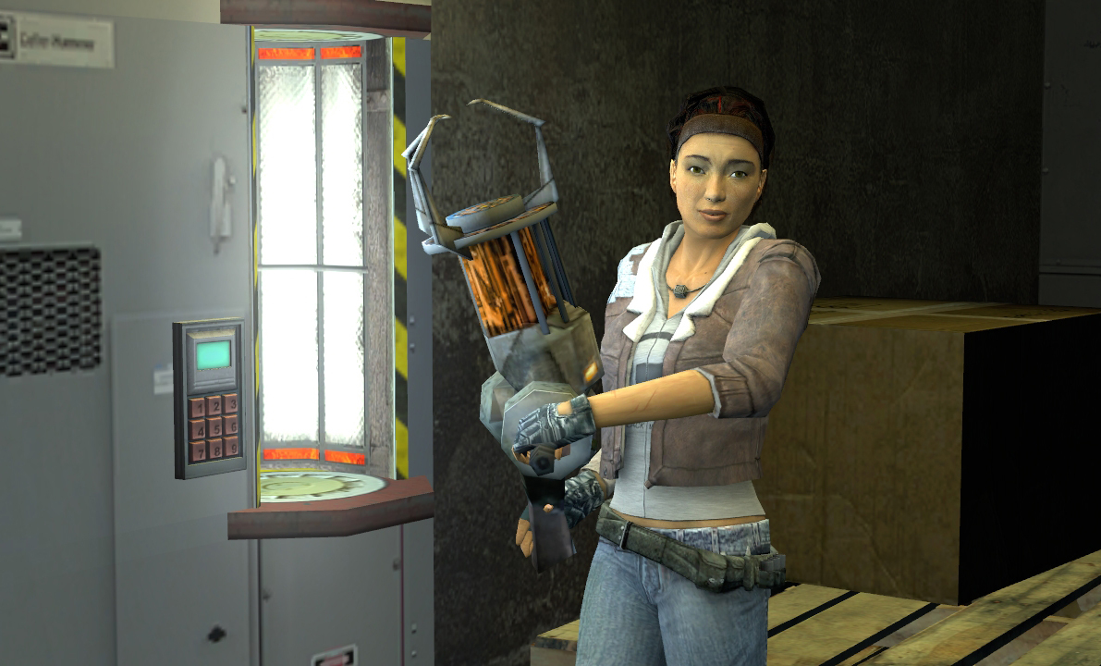

Slide 30
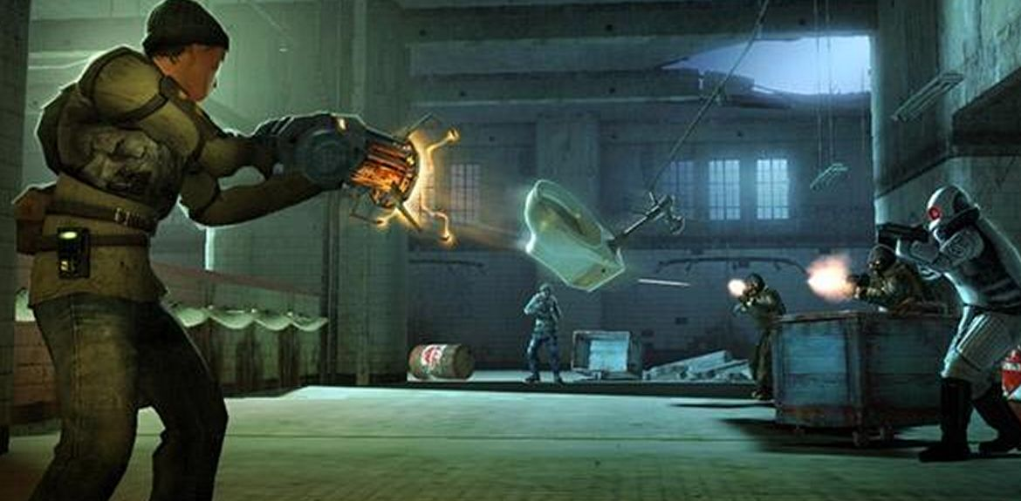

Slide 31
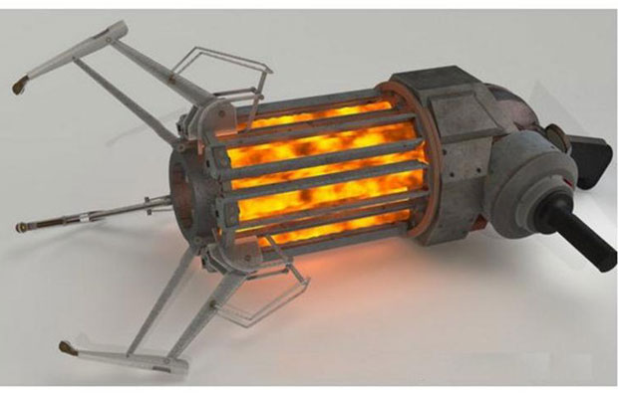
Gravity Gun
Check for a key press or mouse click
If there isnt already a pick up
Make a ray from the camera position and look
Perform a ray cast into the scene
If it intersects something (check if the picked up object is != null)
Check its not the world, itself or the camera
Pick something up
If something is picked up…
Calculate the hold pos (some units in front of the camera)
Calculate velocity
Calculate direction = holdPos – pickedUpPos
Scale by power factor
Normalise
Scale by max velocity
Set the velocity of the picked up rigid body (which will move it to the hold pos)
If the raycast is unsuccessful
Set the picked up object to be null

Slide 32
